Slide 1
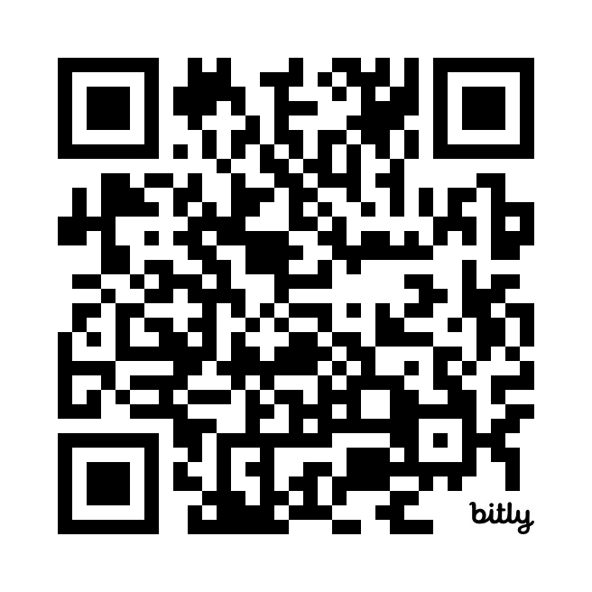
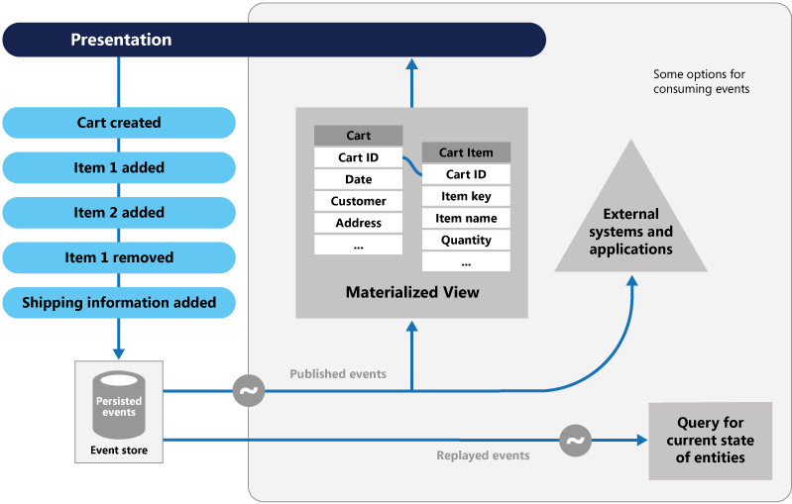
Event Sourcing Quiz
https://bit.ly/3PAQ27S

